Slide 1
Electronic Devices
Mid Term Lecture - 08
Faculty Name: Mr. A N M Shahebul Hasan
Email : shahebul@aiub.edu
Reference book:
Electronic Devices and Circuit Theory (Chapter-3)
Robert L. Boylestad and L. Nashelsky , (11th Edition)

Slide 2
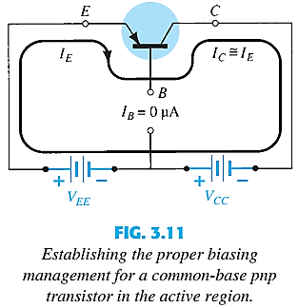
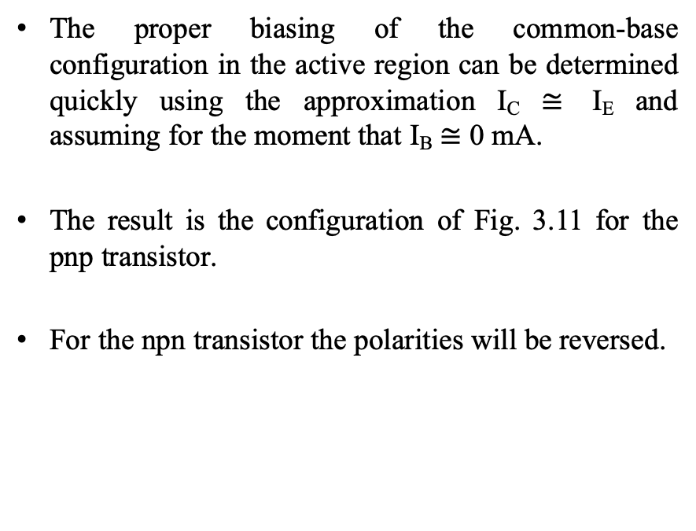
BIASING
The proper biasing of the common-base configuration in the active region can be determined quickly using the approximation I_{C} $≅$ I_{E} and assuming for the moment that I_{B} $≅$ 0 mA.
The result is the configuration of Fig. 3.11 for the pnp transistor.
For the npn transistor the polarities will be reversed.

Slide 3
COMMON-EMITTER CONFIGURATION
It is called common-emitter configuration since :
emitter is common or reference to both input and output terminals.
emitter is usually the terminal closest to or at ground potential.
Almost all amplifier design is using connection of CE due to the high gain for current and voltage.
Two set of characteristics are necessary to describe the behavior for CE:
input (base terminal) and
output (collector terminal) parameters.

Slide 4
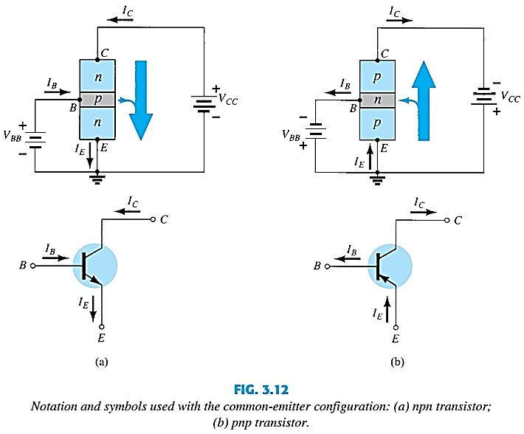
COMMON-EMITTER CONFIGURATION

Slide 5
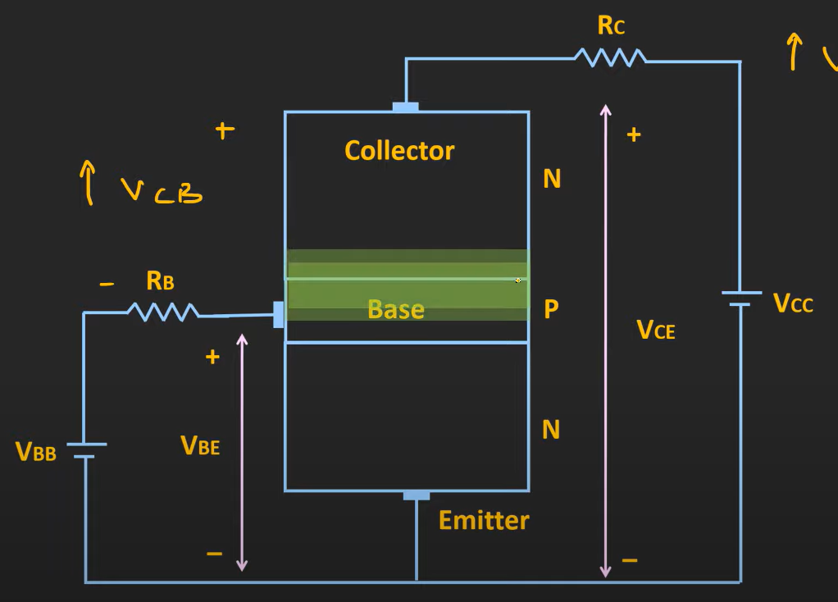
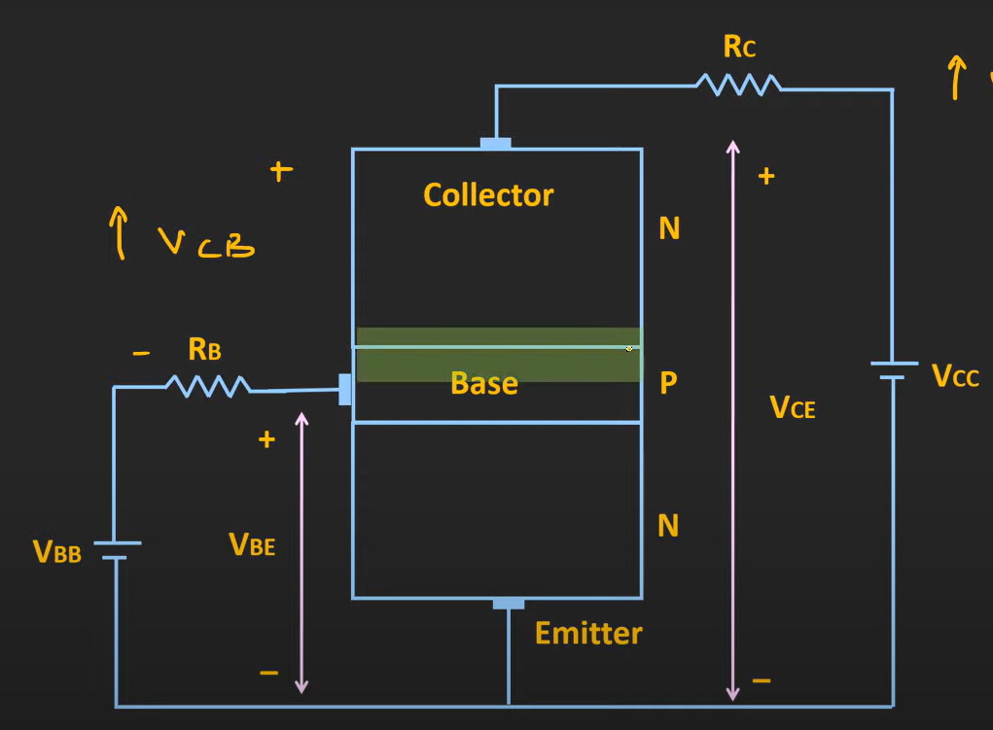
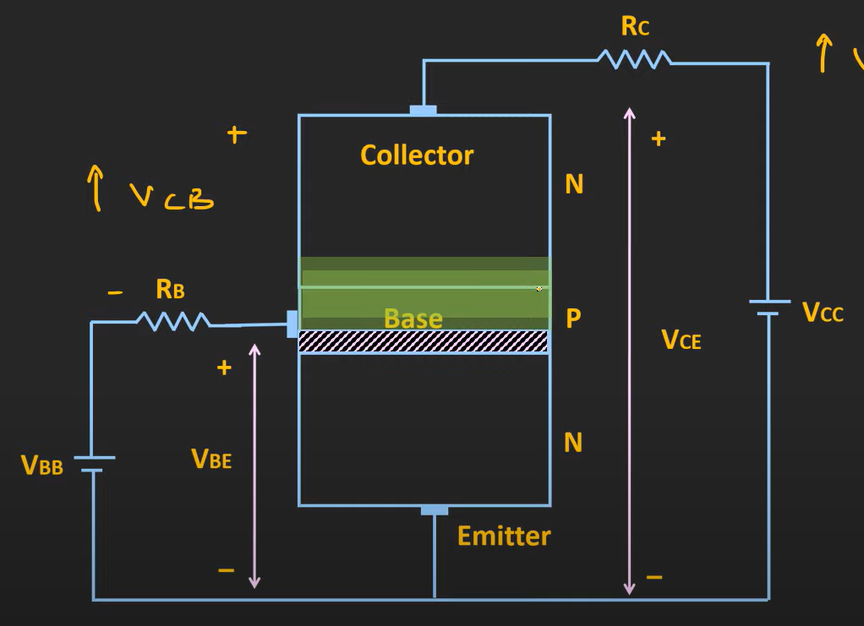
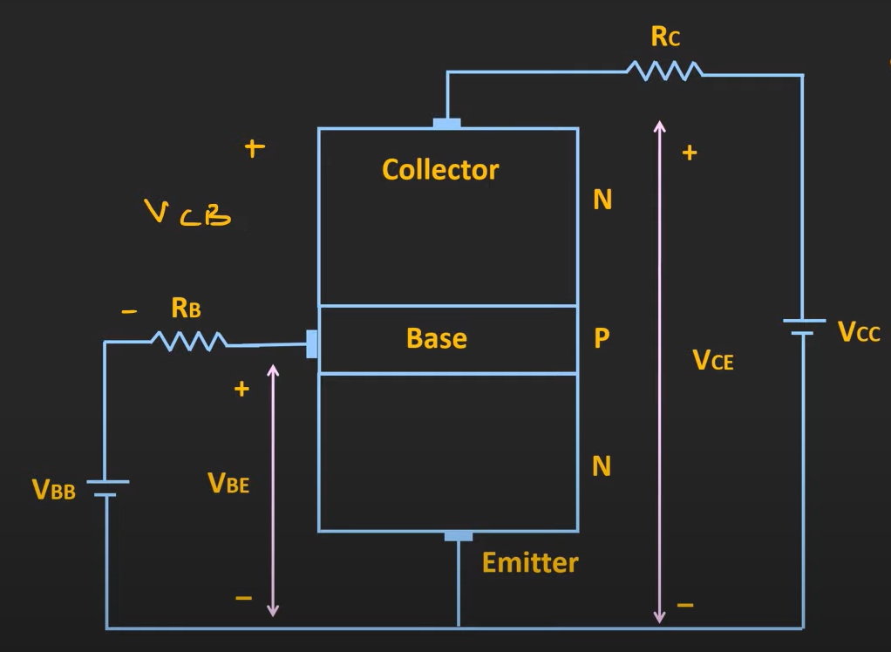
COMMON-EMITTER CONFIGURATION
V_{CE} = V_{CB} + V_{BE}
V_{CE} = V_{CB} + V_{BE (Fixed)}
V_{CB}
V_{CB}
V_{CB}
V_{CB}
V_{CE} = I_{B}
I_{B}

Slide 6
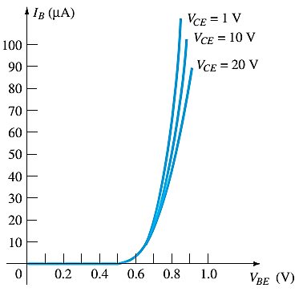
COMMON-EMITTER CONFIGURATION
Input characteristics for a
common-emitter n-p-n transistor
I_{B} is micro-amperes compared to milli-amperes of I_{C}.
I_{B} will flow when V_{BE} > 0.7V for silicon and 0.3V for germanium
Before this value I_{B} is very small.
Base-emitter junction is forward bias
Increasing V_{CE} will reduce I_{B} for different values.
If V_{CE} is increased, the depletion region width increases. The base region is lightly doped as compared to the collector region.
The width of the base region decreases which in turn reduces the input current (I_{B}) produced in the base region.
Foe increasing V_{CE} it will require
More V_{BE} to turn on the region

Slide 7
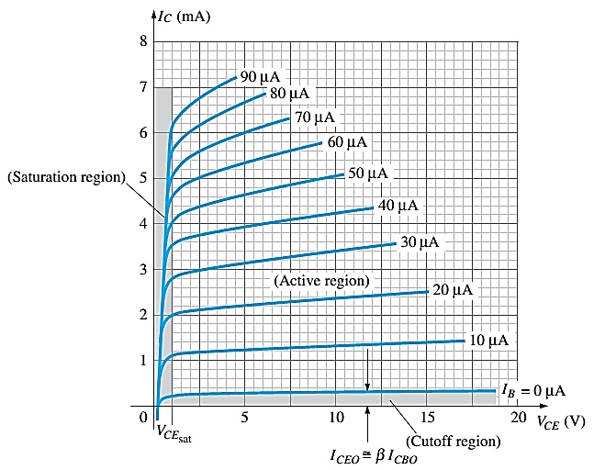
COMMON-EMITTER CONFIGURATION
Output characteristics for a
common-emitter n-p-n transistor
For small V_{CE} (V_{CE} < V_{CESAT}, I_{C} increase linearly with increasing of V_{CE}
I_{B}(uA) is very small compare to I_{C} (mA). Small increase in I_{B} cause big increase in I_{C}
I_{B}=0 A → I_{CEO} occur.
Noticing the value when I_{B}=0A. There is still some value of current flows.

Slide 8
COMMON-EMITTER CONFIGURATION
ACTIVE REGION | SATURATION REGION | CUTOFF REGION
BE junction is forward biased | BE and CB junctions are forward biased, thus the values of I_{B} and I_{C} is too big | Region below I_{B} = 0 µA is to be avoided if an undistorted output signal is required
CB junction is reverse biased | The value of V_{CE} is too small | BE junction and CB junctions are reverse biased
Can e employed for voltage, current and power amplification | Suitable region when the transistor is used a logic switch | I_{B} = 0, I_{C} not zero, during this condition I_{C} = I_{CEO} where this is the current flow when BE is reverse biased
 | NOT and avoid this region when the transistor as an amplifier

Slide 9


BETA (β) OR AMPLIFICATION FACTOR
The ratio of dc collector current (I_{C}) to the dc base current (I_{B}) is dc beta (β_{dc} ) which is dc current gain where I_{C} and I_{B} are determined at a particular operating point, Q-point (quiescent point).
It’s defined by the following equation:
For ac conditions an ac beta has been defined as the changes of collector current (I_{C}) compared to the changes of base current (I_{B}) where I_{C} and I_{B} are determined at operating point.
It can be defined by the following equation:

Slide 10

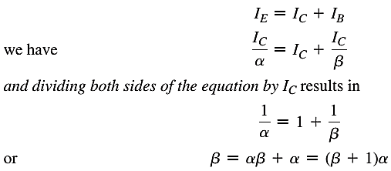


RELATIONSHIP ANALYSIS BETWEEN α AND β

Slide 11
COMMON–COLLECTOR CONFIGURATION
Also called emitter-follower (EF).
It is called common-emitter configuration since both the signal source and the load share the collector terminal as a common connection point.
The output voltage is obtained at emitter terminal.
The input characteristic of common-collector configuration is similar with common-emitter configuration.
Common-collector circuit configuration is provided with the load resistor connected from emitter to ground.
It is used primarily for impedance-matching purpose since it has high input impedance and low output impedance.

Slide 12
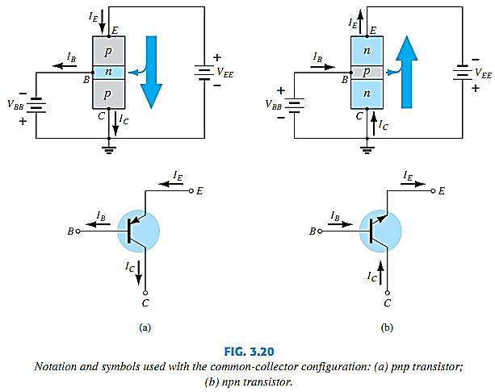
COMMON–COLLECTOR CONFIGURATION

Slide 13
LIMITS OF OPERATION
Many BJT transistor used as an amplifier. Thus it is important to notice the limits of operations.
At least 3 maximum values is mentioned in data sheet.
There are:
Maximum power dissipation at collector: P_{Cmax} or P_{D}
Maximum collector-emitter voltage: V_{CEmax} ;sometimes named as V_{(BR)CEO)} or V_{CEO}.
Maximum collector current: I_{cmax}
There are few rules that need to be followed for BJT transistor used as an amplifier. The rules are:
transistors need to operate in active region!
I_{C} < I_{cmax}
P_{C} < P_{Cmax}

Slide 14
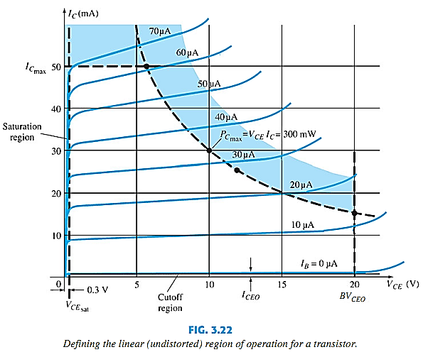
LIMITS OF OPERATION
Note: V_{CE} is at maximum and I_{C} is at minimum (I_{Cmax}=I_{CEO}) in the cutoff region. I_{C} is at maximum and V_{CE} is at minimum (V_{CE} _{max} = V_{CEsat} = V_{CEO}) in the saturation region. The transistor operates in the active region between saturation and cutoff

Slide 15
Thank You

